Slide 1
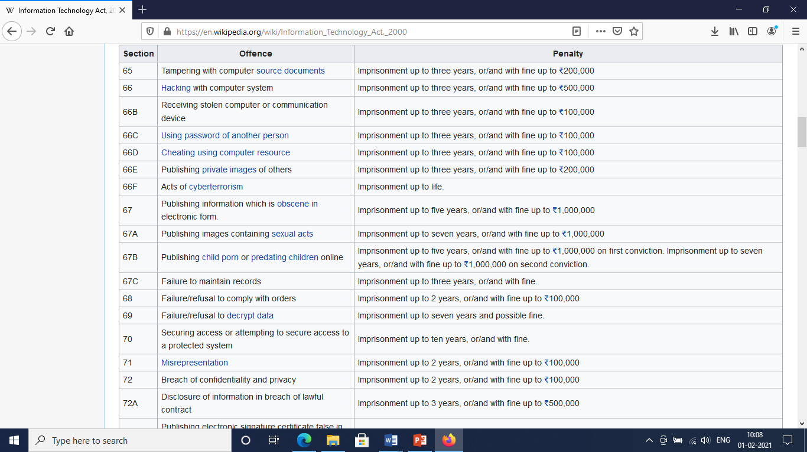

Slide 2
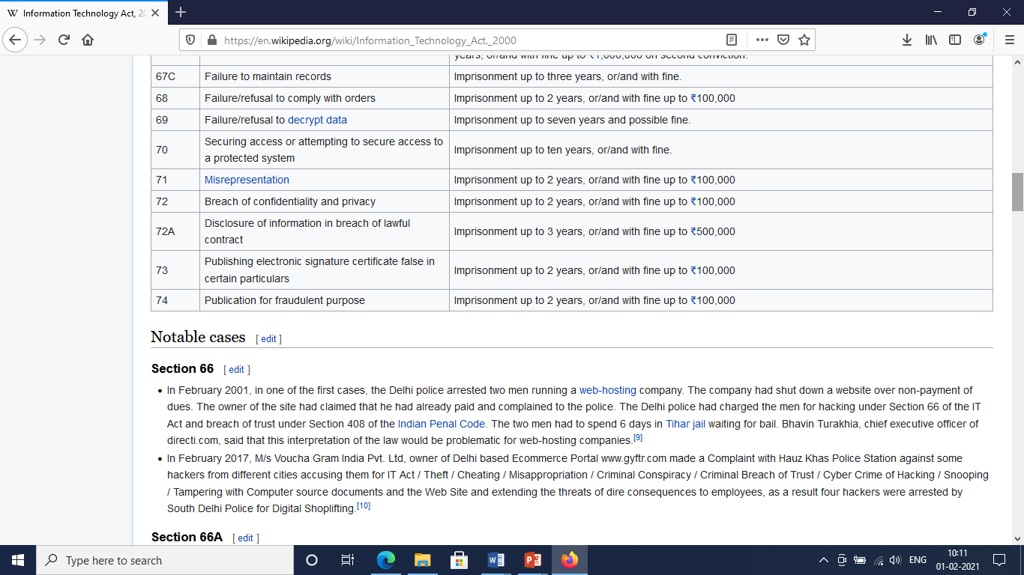

Slide 3
Notable Cases
https://en.wikipedia.org/wiki/Information_Technology_Act,_2000

